Slide 1
PLANNING

Slide 2

Planning
Planning
  coping with uncertainty by formulating future actions to achieve specified results
  setting goals and deciding how to achieve them

Slide 3
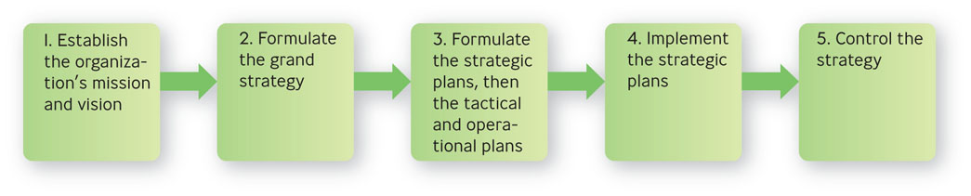
Planning & Strategic Management

Slide 4
How Planning Helps You
1. Helps you check on your progress
2. Helps you coordinate activities
3. Helps you think ahead
4. Helps you cope with uncertainty

Slide 5
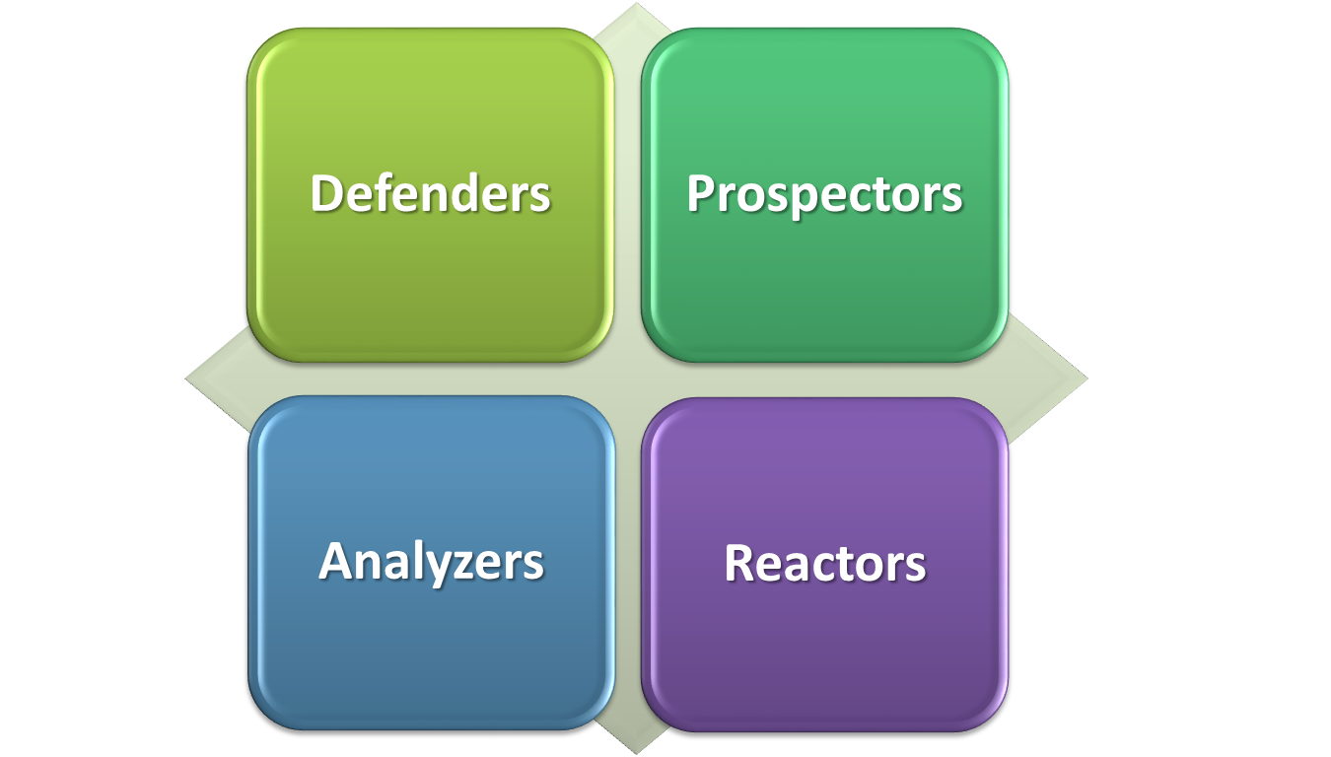
Four Basic Strategy Types

Slide 6

Four Basic Strategy Types
Defenders
  “Let’s stick with what we do best, avoid other involvements “
  experts at producing and selling narrowly defined products
Notes:
Multimedia Lecture Support Package to Accompany Basic Marketing
Lecture Script 6-<number>

Slide 7
Four Basic Strategy Types
Prospectors
  “Let’s create our own opportunities, not wait for them to happen”
  focus on developing new products and in seeking out new markets, rather than waiting for things to happen

Slide 8
Four Basic Strategy Types
Analyzers
  “Let others take the risks of innovating, & we’ll imitate what works best”
  let other organizations take the risks of product development and marketing and then imitate what seems to work best
Notes:
Multimedia Lecture Support Package to Accompany Basic Marketing
Lecture Script 6-<number>

Slide 9

Four Basic Strategy Types
Reactors
  “Let’s wait until there’s a crisis, then we’ll react”
  make adjustments only when finally forced to by environmental pressures

Slide 10

Red Bull
  Austrian energy dring maker, which was released into the US in 1997, believes in making unusual marketing moves, such as creating a festival for homemade flying machines and building a half-pipe for Olympic snowboarder Shaun White. In 2010, the company opened a 220 million dollar soccer stadium in New Jersey.
  What strategy type is being followed here?

Slide 11
http://www.shaunwhite.com/
Answer: Prospectors
  “Let’s create our own opportunities, not wait for them to happen”

Slide 12
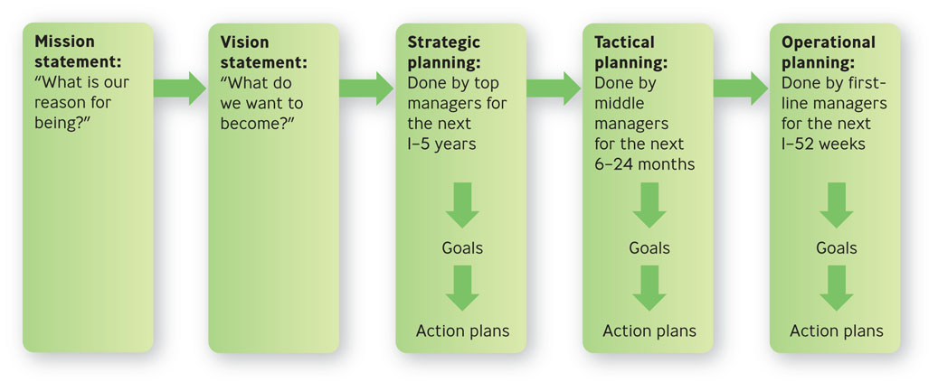
Making Plans

Slide 13
Mission & Vision Statements
Mission statement
  expresses the purpose of the organization: “Why do we exist?”
Vision statement
  long-term goal describing “what” an organization wants to become
  clear sense of the future and the actions needed to get there

Slide 14

Example: Nest Fresh Eggs
“NestFresh strives to provide you and your family with a more sustainable, humane alternative to conventional eggs, which are produced in caged facilities.
We insist on producing cage free and organic eggs to create awareness about the need for humane treatment of egg laying hens and the importance of environmental responsibility.”
Notes:
http://nestfresh.com/ourstory.aspx

Slide 15

Mission Statement: Hilton Hotels
“To fill the earth with the light and warmth of hospitality”

Slide 16
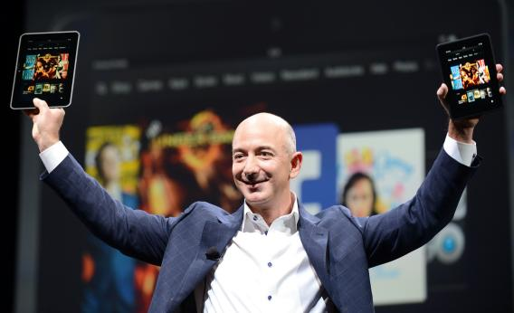
Mission Statement: Amazon
“Use the Internet to offer products that educate, inform and inspire. We decided to build an online store that would be customer friendly and easy to navigate and would offer the broadest possible selection...”

Slide 17

Mission Statement: Patagonia
“Build the best product, cause no unnecessary harm, and use business to inspire and implement solutions to the environmental crisis”

Slide 18
Vision Statement: Hilton Hotels
“To be the first choice of the world’s travelers, building on the rich heritage and strength of our brands by consistently delighting our customers, investing in our team members, delivering innovative products and services, expanding our family of brands, and continously improving performance”

Slide 19
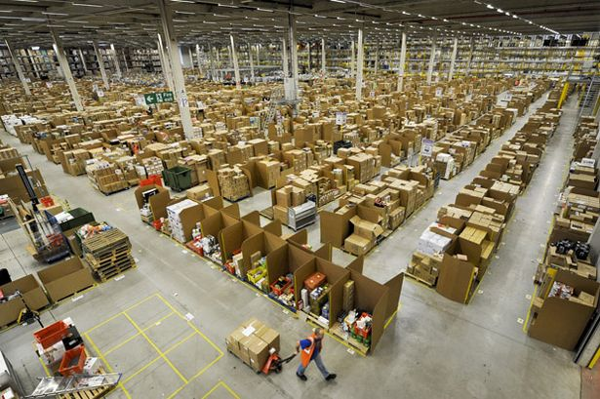
Vision Statement: Amazon
“Our vision is to be earth’s most customer-centric company; to build a place where people can come to find and discover anything they might want to buy online.”

Slide 20
Vision Statement: Patagonia
“We prefer the human scale to the corporate, vagabonding to tourism, and the quirky to the toned-down and flattened one.”

Slide 21
Three Types of Planning for Three Levels of Management:
Strategic planning
  determine what the organization’s long-term goals should be for the next 1-5 years with the resources they expect to have available

Slide 22
Three Types of Planning for Three Levels of Management:
Tactical planning
  determine what contributions their departments or similar work units can make during the next 6-24 months

Slide 23

Three Types of Planning for Three Levels of Management:
Operational planning
  determine how to accomplish specific tasks with available resources within the next 1-52 weeks

Slide 24
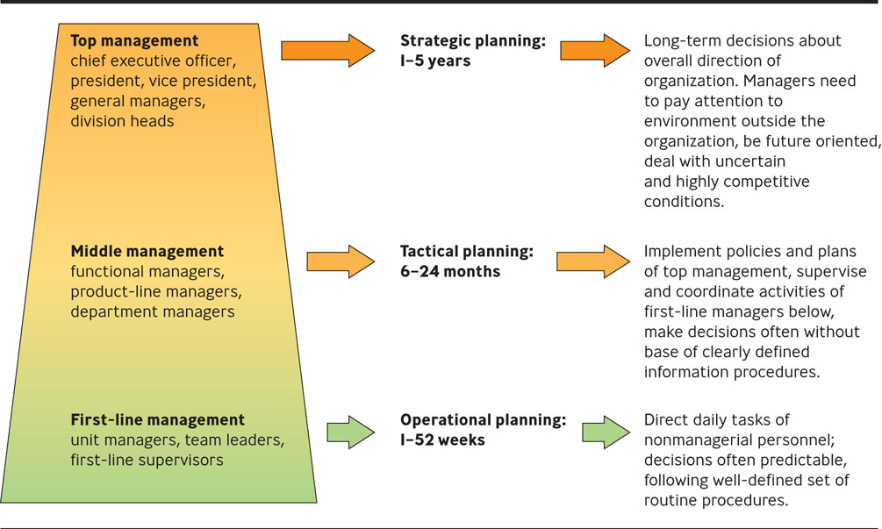
Three Levels of Management, Three Types of Planning

Slide 25
Goals, Action Plans & Operating Plans
Goals
  specific commitment to achieve a measurable result within a stated period of time
  also known as an objective
  strategic, tactical, operational

Slide 26
Goals
Strategic goals
  set by and for top management and focus on objectives for the organization as a whole.
Tactical goals
  set by and for middle managers and focus on the actions needed to achieve strategic goals.
Operational goals
  set by and for first-line managers and are concerned with short-term matters associated with realizing tactical goals.

Slide 27



Example: Southwest Airlines
Notes:
America’s favorite airline on quality-of-flight measures

Slide 28

Strategic Goals:
  To ensure that airline is highly profitable by:
  Keeping costs and fares down
  Offering a superior on-time arrival record
  Keeping passangers happy

Slide 29
Tactical Goals:
  Cutting costs in its maintenance program
  Limiting the turnaround time between flights to 20 minutes
  Flying to less-congested airports thus saving time and money by avoiding traffic.
  No in-flight meals, only peanuts

Slide 30
Operational Goals
  Enhancing productivity in the unloading, refueling and cleaning of arriving planes

Slide 31
Goals, Action Plans & Operating Plans
Operating plan
  designed for a 1-year period
  defines how you conduct your business based on the action plan
  identifies clear targets such as revenue, cash flow, and market share

Slide 32
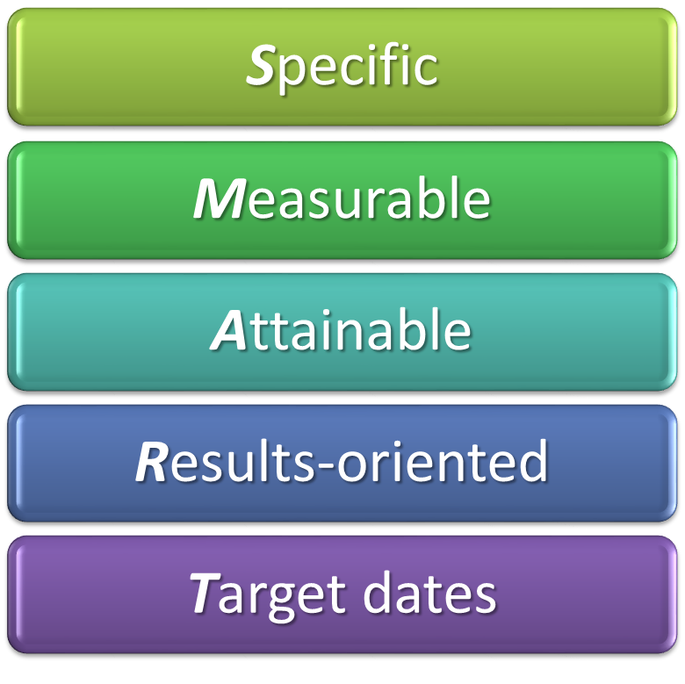
SMART Goals:
Notes:
•

Slide 33
Specific:
Goals should be stated in specific rather than vague terms.
The goal that “As many planes as possible should arrive on time” is too general.
The goal that “Ninety percent of planes should arrive within 15 minutes of the scheduled arrival time” is specific.

Slide 34
• Measurable:
Whenever possible, goals should be measurable, or quantifiable
“90% of planes should arrive within 15 minutes . . .”
Quality
“Improve the quality of customer relations by instituting 10 follow-up telephone calls every week”

Slide 35
• Attainable:
Goals should be challenging, but above all they should be realistic and attainable.
Always, the goals should be achievable within the scope of the time, equipment, and financial support available.
If too easy ( “half the flights should arrive on time”), won’t impel people to make much effort.
(“all flights must arrive on time, regardless of weather”), employees won’t even bother trying.

Slide 36
Results-oriented:
Only a few goals should be chosen
ex: five/ work unit.
And they should be results-oriented —they should support the organization’s vision.
In writing out the goals, start with the word “To” and follow it with action-oriented verbs—“complete,” “acquire,” “increase”
“to decrease by 10% the time to get passengers settled in their seats before departure.”

Slide 37
• Target dates:
Specify the target dates or deadline dates.
“To improve its on-time arrivals by 10% overnight.” (it’s unrealistic)
However, target date 3 to 6 months is to be achieved.
That allows enough time for lower-level managers and employees to reorganize their systems and work habits and gives them a clear time frame in which they know what they are expected to do.

Slide 38
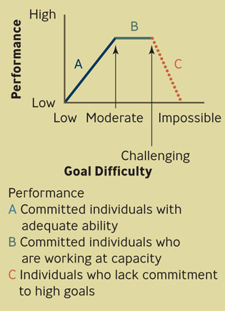
Relationship Between Goal Difficulty and Performance

Slide 39
The Planning/Control Cycle
1. Make the plan
2. Carry out the plan
3. Control the direction by comparing results with the plan
4. Control the direction by taking corrective action in two ways:
  Correcting deviations
  Improving future plans

Slide 40
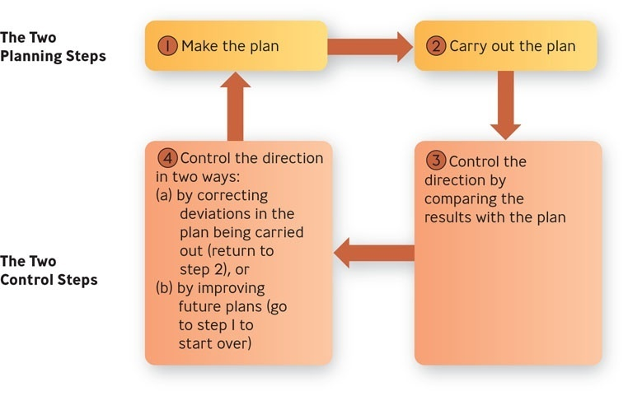
The Planning/Control Cycle

